Slide 1

Lecture 9.3
Array of Objects with Methods - Reading Materials

Slide 2
Study Instructions
In this reading materials, we have provided examples and quick exercises for some commonly used array functions.
Please test these with your local development environment (Visual Studio Code) or repl.it (Please check out the best practices on next page)
You don’t need to remember the exact syntax, input and output of the examples, but you should have an understand what array functions could do for you.
In reality, you can always Google for the function usage, or refer to this notes. But the prerequisite is that you know what are the keywords to search in Google.

Slide 3
How to Use the Sample Code?
In this study materials, we have provided a use case and sample code on each of the page. We would like you to test each of them.
The best way to learn, is to type the whole code again, instead of copy pasting. (That’s why we provided the code as a picture instead of text)
While typing, try to understand the meaning of each line instead of just typing the code line by line. Testing without understanding what you are doing is meaningless.
After testing, try to make changes to the code, and see if the new results is something that you expected.

Slide 4
Array of Objects

Slide 5
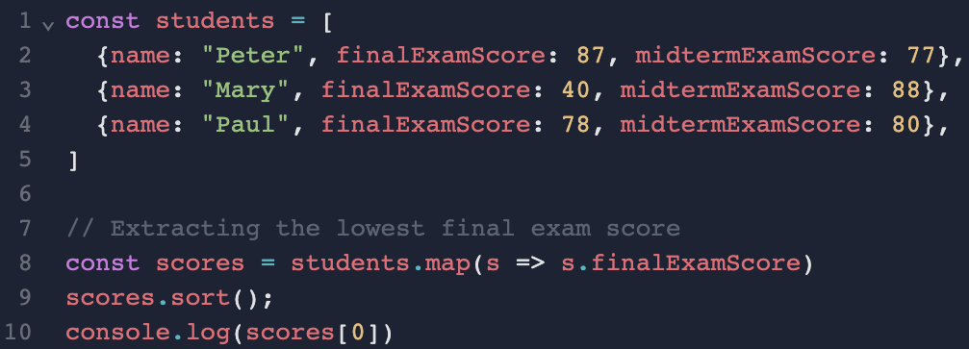
Extracting Info from Array of Objects

Slide 6
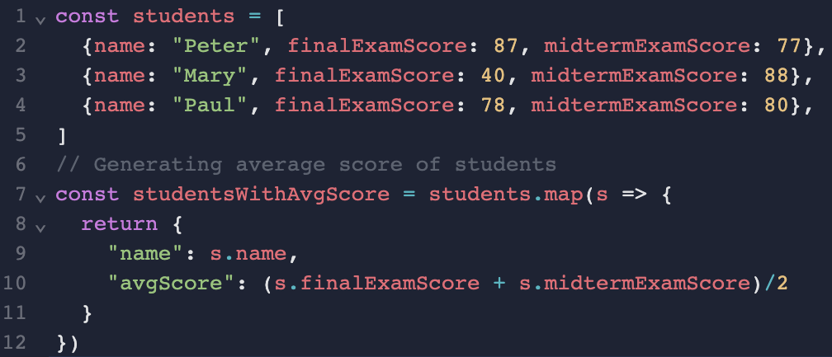
Generating Info from Array of Objects

Slide 7
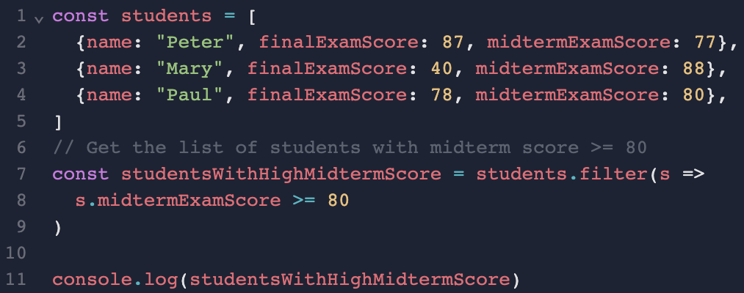
Filter Items from Array of Objects

Slide 8
Objects as an Object Property

Slide 9
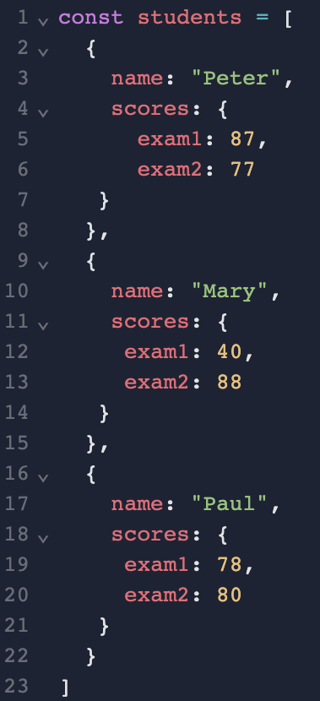

Array of Object as Object Property

Slide 10
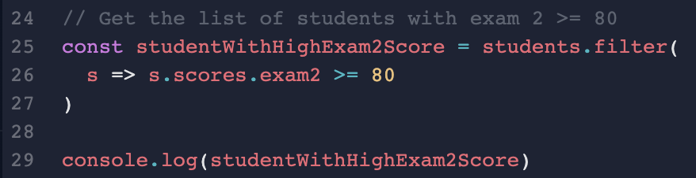
Filter Items from "Object Property"

Slide 11
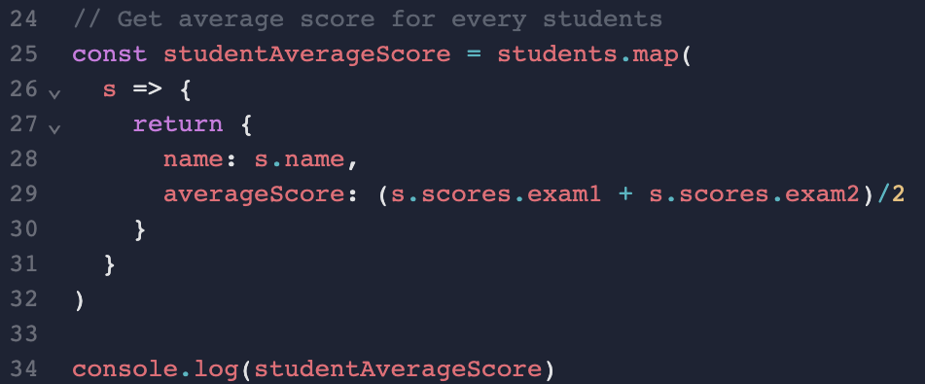
Generating Information from "Object Property"

